Slide 1
Needfinding for Language Learning
Glenn Davis
Brian Liu
John Reyna
Tamara Prstić

Slide 2

Glenn
PhD Education (1st year)
Native language: English
Learned: Japanese, Chinese, Spanish (basic)
Brian
Senior
Native language: English
Learned: Chinese (basic)
Piano teacher for 9 years

Slide 3

John
Final year coterm
Native Language: English
Limited Working Proficiency: Spanish
Tamara
Sophomore
Native Language: Serbian
Proficient in: English, Croatian/Bosnian, Italian, Latin

Slide 4
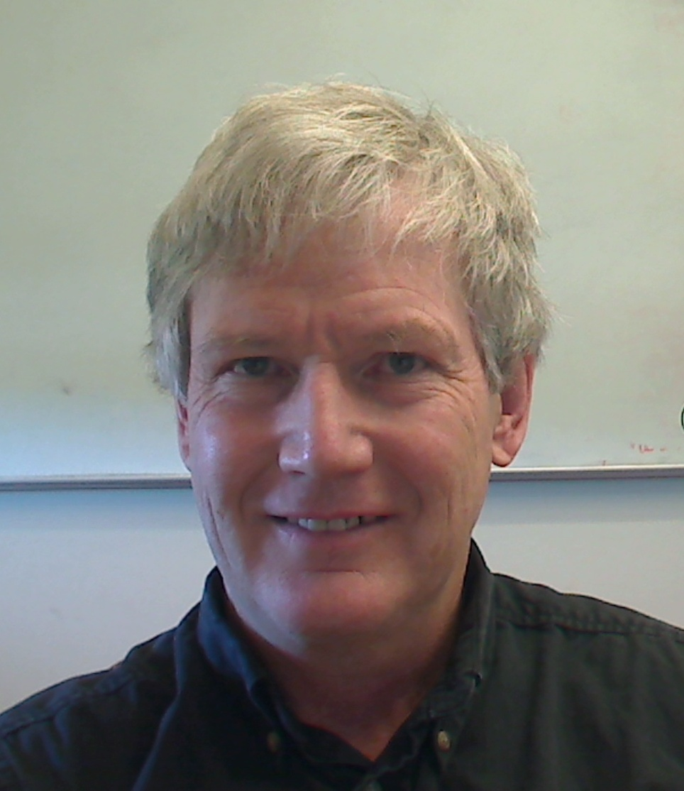
Phil Hubbard
Director of English for Foreign Students Program at Stanford, Senior Lecturer in Linguistics
Notes:
Phil is a domain expert and can provide perspective as a language teacher for several decades
Glenn had a meeting with him to discuss research and also asked him a few questions related to our project
Age: Early 60’s

Slide 5

Elise
Sophomore majoring in English and French at Xi’an Jiaotong University in China
Notes:
Elise adds diversity to our participants by providing an overseas perspective, also learning two different languages
Interview was done over audio chat
she worked with Glenn on a program in the summer
Age: 20

Slide 6
Michael Diaz
Former English tutor and administrator for Habla
Notes:
Michael is John’s friend from undergrad and brief coworker at Habla. Michael spent almost a decade learning Spanish in school and four years as a member of Habla, two as a tutor, two as an administrator. He now uses spanish to provide medical treatment to native speakers.
He is very much a self-learner and has seen what happens when quality learning materials aren’t present.
Age 25, current med student at UCSF
Answered my questions in a Google Doc

Slide 7

Brian’s mom
Xiuzhi, foreign medical graduate, came to U.S. in mid-late 20’s
Add picture of your mom here.
Literally.
Notes:
Xiuzhi, foreign medical graduate, came to U.S. in mid-late 20’s
Chosen by virtue of being a mom.
What was the hardest part of being a non-English speaker was she started living in U.S.?
Interviewed via video call
54
Chinese
English

Slide 8
Notes:
What do you think about current language learning apps?
People who finish them have some useful chunks of language, but

Slide 9
Phil: People are missing some important things such as interactive language.

Slide 10
Notes:
Do you use your phone for anything related to learning language?
To look up words and check their usage, but it wasn’t good for finding useful words and expressions

Slide 11
Elise: For some reason I find that paper dictionaries are better for learning, even though they’re inconvenient.

Slide 12
Notes:
Think of a good experience when you’ve used English outside of class
I was asked to be a tour guide for some international teachers at my university. I didn’t play a very important part but

Slide 13
Elise: I was able to use my English to talk with a little girl (a teacher’s daughter) and introduce some history to her.

Slide 14
Notes:
Did Habla have a specific method of tutoring, or did the administrators let the tutors do their own thing? Do you think their approach was successful?
I also think one distinct advantage to Habla was our focus on longitudinal relationships between Stanford students and janitors.

Slide 15
Michael: It fostered a good environment for learning in which the janitors felt comfortable with the students and were able to build meaningful relationships over years.

Slide 16
Notes:
Was there anything specific you would change about learning a new language?
If only there was a way to practice her English in my room for three hours straight

Slide 17
Xiuzhi: without bothering or dealing with anyone else’s schedule, presence, or feelings.

Slide 18

http://tonyzambito.com/wp-content/uploads/2015/05/insight-me.jpg

Slide 19


Slide 20
SAID
Missing interaction
Not motivated
Prefer reading to talking, or vice versa, so they had a weakness
THOUGHT
Difficult to find someone to practice with
Don’t know how to express self
Textbook is boring
FELT
Embarrassed
Pressured
Unconfident
Judged
DID
Watched pronunciation video but didn’t stick with it

Slide 21
Insight
Good Communication vs Good Grades

Slide 22
Insight
Confidence ->
Motivation ->
Practice ->
Confidence

Slide 23
Insight
Learners don’t want to feel judged, inadequate, nor bothersome.

Slide 24
Surprise Insight
Many learners don’t even try apps...

Slide 25
Need
What about apps is ineffective?
Notes:
Little overhead between real world and tool
Should be able to pull out a phone in the real world and have an answer in seconds

Slide 26
Need
Motivation
(Collaborative goal?)
(Gamification?)
Notes:
We need to take grades out of the equation and provide a more useful incentive

Slide 27
Need
Non judgemental, stress-free, real conversations

Slide 28
Need
All-around learning
Notes:
So that people don’t develop a specific weakness that turns into a fear

Slide 29
Summary
Current language learning apps are not motivating
Jumpstart the process of improving confidence without feelings of embarrassment or insecurity
Pronunciation may be a key issue
People need practice with real conversations

